Slide 1
Theory of Production
The act of production involves the transformation of inputs into outputs. The word production in economics is not merely confined to bringing about physical transformation in the matter, it is creation or addition of value
The relation between inputs and output of a firm has been called the ‘Production Function’

Slide 2
PRODUCTION FUNCTION: TRANSFORMING INPUTS INTO OUTPUT
The functional relationship between physical inputs and physical output of a firm is known as production function. Algebraically, production function can be written as
Q = f (L, K, M)
where Q stands for the quantity of output, L, K and M stand for the quantities of factors labor, capital and raw materials respectively.
More precisely, the production function states the maximum quantity of output that can be produced with any given quantities of various inputs.

Slide 3
First, we study the production function when the quantities of some inputs such as capital and land are kept constant and the quantity of one input such as labour (or quantities of few inputs) is varied. This kind of production [Q = f(L, K )] is called short-run production function.
Secondly, we study production function (input-output relation) by varying all inputs and this is called long-run production function and can be expressed as Q = f(L, K, M). This forms the subject-matter of the law of returns to scale. Generally, the terms constant and increasing returns are used with reference to constant and increasing returns to scale

Slide 4
CONCEPTS OF PRODUCT
Regarding physical production by factors there are three concepts (1) Total Product, (2) Aver- age Product, and (3) Marginal Product
(1) Land | (2) Labor | (3) TP | (4) AP_{L} | (5) MP_{L}
1 | 0 | 0 | 0 | ...
1 | 1 | 3 | 3 | 3
1 | 2 | 8 | 4 | 5
1 | 3 | 12 | 4 | 4
1 | 4 | 15 | 3 3 4 | 3
1 | 5 | 17 | 3 2 5 | 2
1 | 6 | 17 | 2 5 6 | 0
1 | 7 | 16 | 2 2 7 | 21
1 | 8 | 13 | 1 5 8 | 23

Slide 5
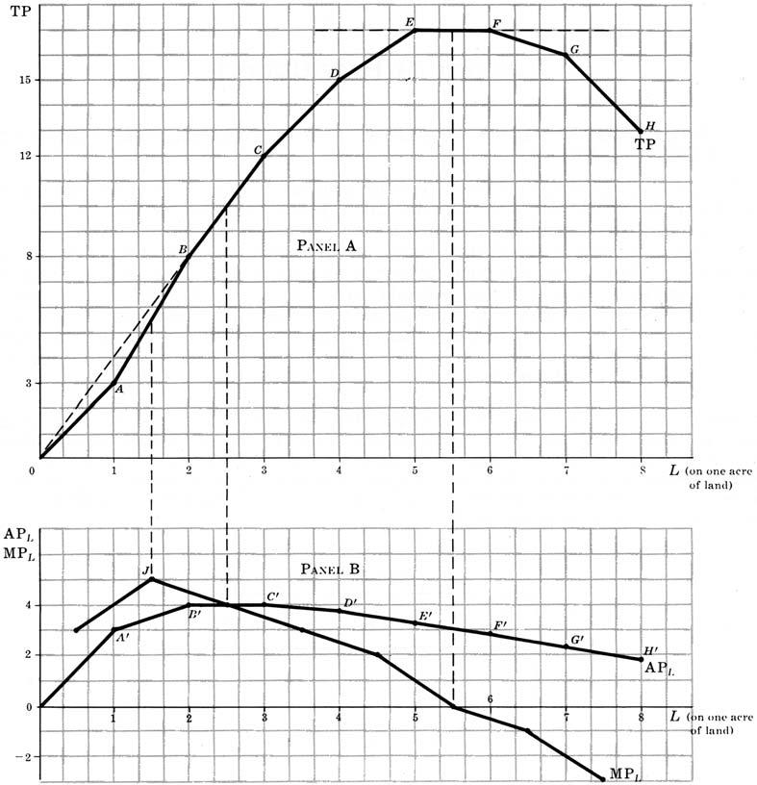
THE SHAPES OF THE AVERAGE AND MARGINAL PRODUCT CURVES
The MP_{L} between two points on the TP curve is equal to the slope of the TP curve between the two points. The MP_{L} curve also rises at first, reaches a maximum (before the AP_{L} reaches its maximum), and then declines. The MP_{L} becomes zero when the TP is maximum and negative when the TP begins to decline. The falling portion of the MP_{L} curve illustrates the law of diminishing returns

Slide 6
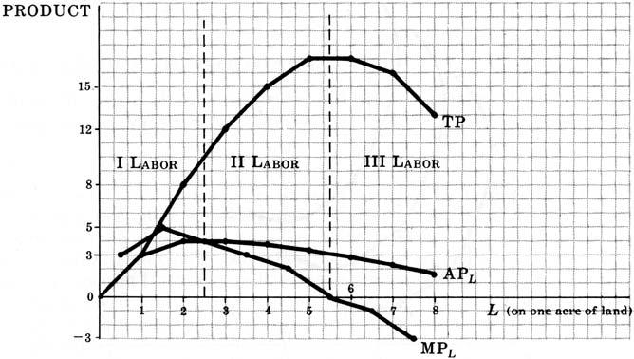
STAGES OF PRODUCTION
We can use the relationship between the AP_{L} and MP_{L} curves to define three stages of production for labor. Stage I goes from the origin to the point where the AP_{L} is maximum. Stage II goes from the point where the AP_{L} is maximum to the point where the MP_{L} is zero. Stage III covers the range over which the MP_{L} is negative. The producer will not operate in stage III, even with free labor, because it would be possible to increase total output by using less labor on one acre of land. Similarly, the producer will not operate in stage I because, stage I for labor corresponds to stage III for land (the MP_{Land} is negative). This leaves stage II as the only stage of production for the rational producer

